Slide 1


DEPI| 2025
GRADUATION PROJECT
Presented by
ONL3_SWD6_G3
Instructor: Abdelrahman Ayman

Slide 2

DEPI| 2025
OUR TESTEING TEAM
Areeg Abdo
Reem Salah
Zahraa Mohamed
Ahmed Atef
Mahmoud Hamdy
Mohamed Abdelfattah

Slide 3
DEPI| 2025
AGENDA
STLC
Manual Testing
Data Base
API Testing
Automation Testing

Slide 4

ONL3_SWD6_G3
INTRODUCTION
Software Testing Life Cycle.
Manual Testing(Exploratory Testing on OpenCart Website).
Data Base.
API Testing: using Postman on the Automation Exercise API.
Automation Testing: on the OpenCart website using Selenium with java.

Slide 5



ONL3_SWD6_G3
TOOLS

Slide 6
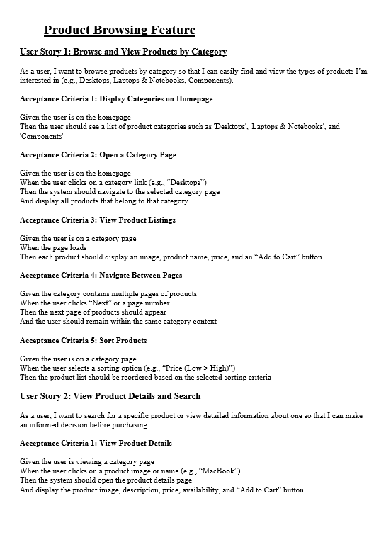

ONL3_SWD6_G3
TEST ANALYSIS
Analyzing the user story to identify testable features , and to define and prioritize associated test conditions , and dicsover ambiguous data.
01

Slide 7
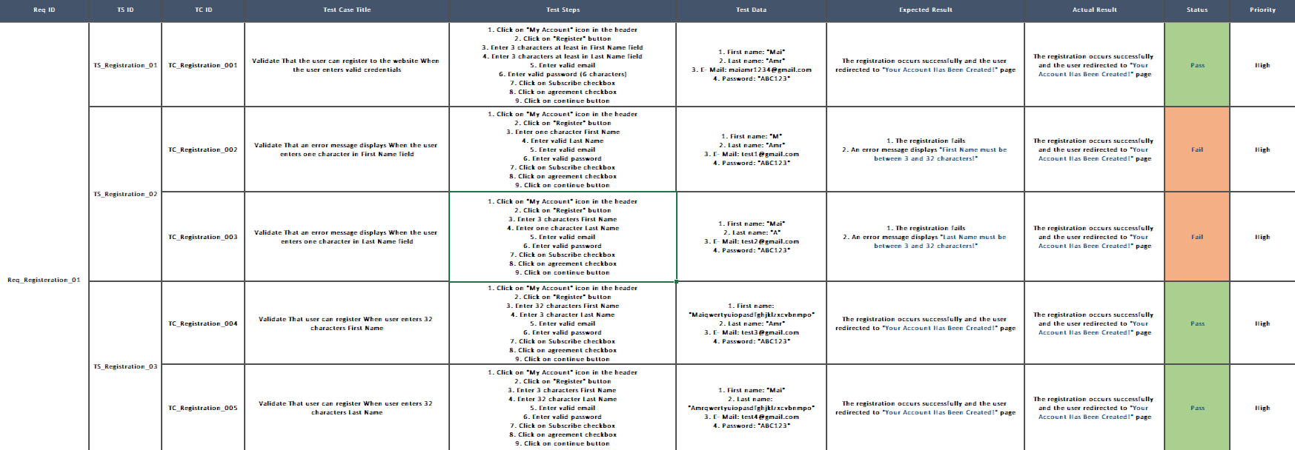
ONL3_SWD6_G3
TEST CASES

Slide 8
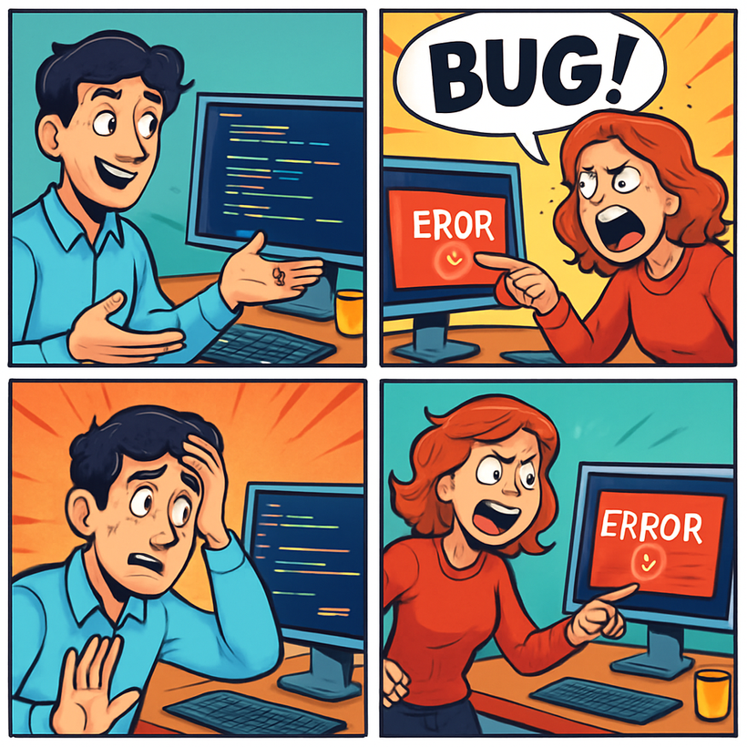
ONL3_SWD6_G3
BUG REPORT

Slide 9
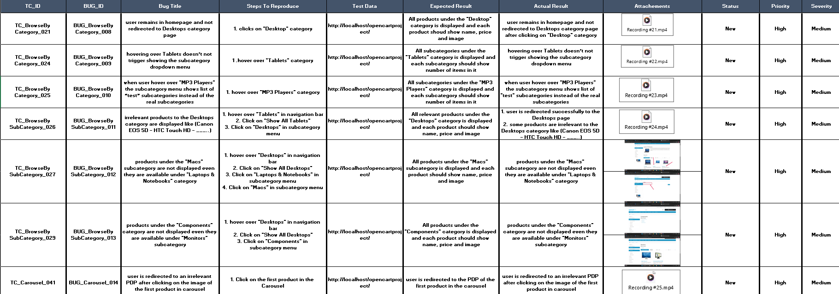
ONL3_SWD6_G3
BUG REPORT

Slide 10

ONL3_SWD6_G3
DATABASE TESTING
Database testing is a type of software testing that focuses on verifying the accuracy, reliability, performance, and security of a database system. It ensures that the data stored in the database is consistent, valid, and can be correctly manipulated according to business requirements.

Slide 11
ONL3_SWD6_G3
THE PROCESS OF DATABASE TESTING
Environment Preparation
Test Case Design
Test Execution
Result Analysis
Reporting

Slide 12
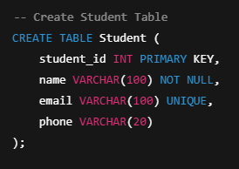
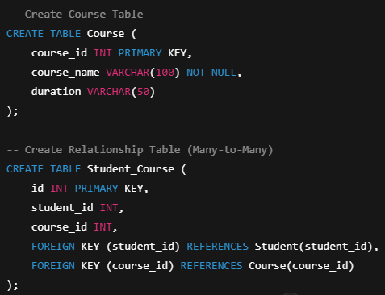
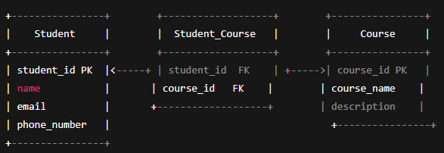
ONL3_SWD6_G3
SAMPLES

Slide 13
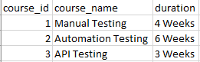
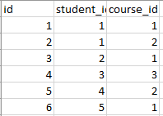
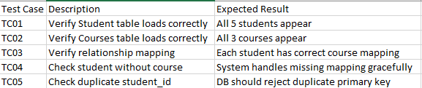
ONL3_SWD6_G3
SAMPLES

Slide 14
ONL3_SWD6_G3
API TESTING
What is API Testing?
Testing API functionality and responses
Ensuring correct request/response behavior
Validating business logic without UI

Slide 15
ONL3_SWD6_G3
OUR API PROJECT
Project Name: Automation Exercise API
Main HTTP Methods: GET – POST – PUT – DELETE
Tools: Postman - Newman

Slide 16
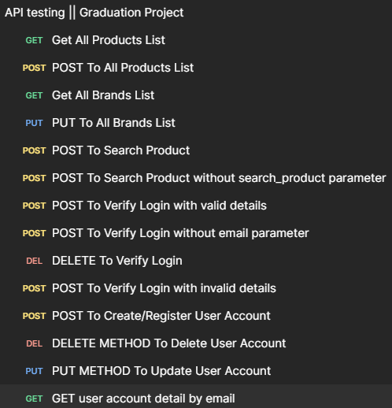




PROJECT STRUCTURE
ONL3_SWD6_G3
Browsing (4 request)
Search (2 request)
Authentication (8 request)

Slide 17
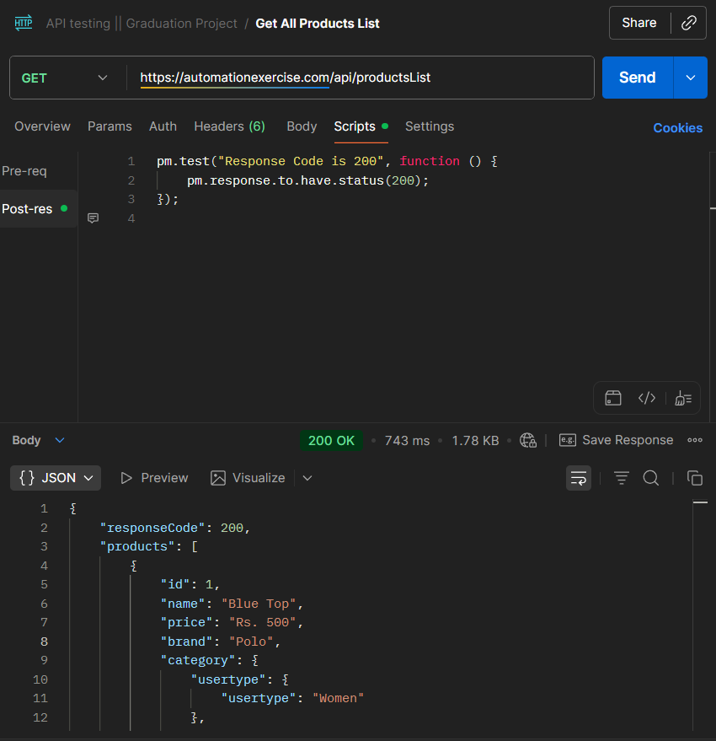
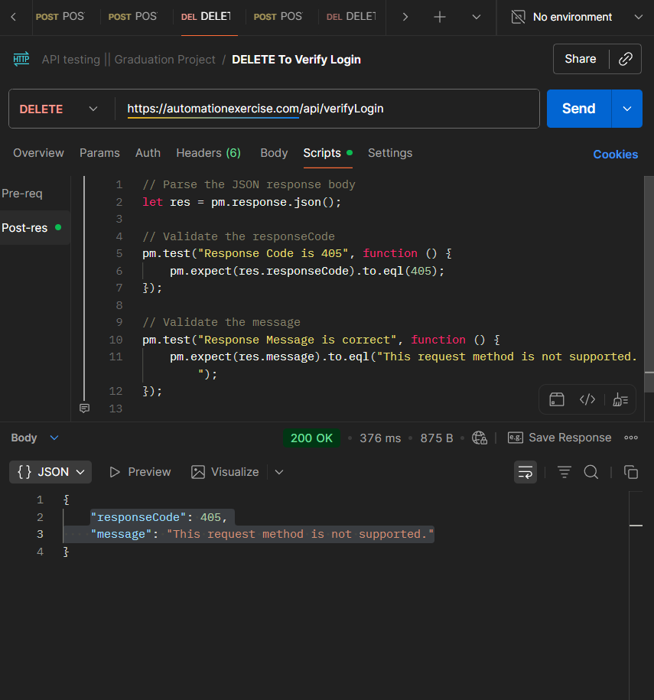
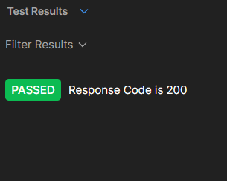
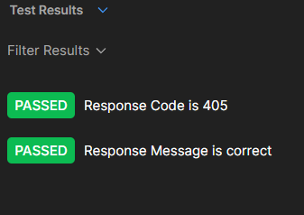
ONL3_SWD6_G3
SAMPLES

Slide 18
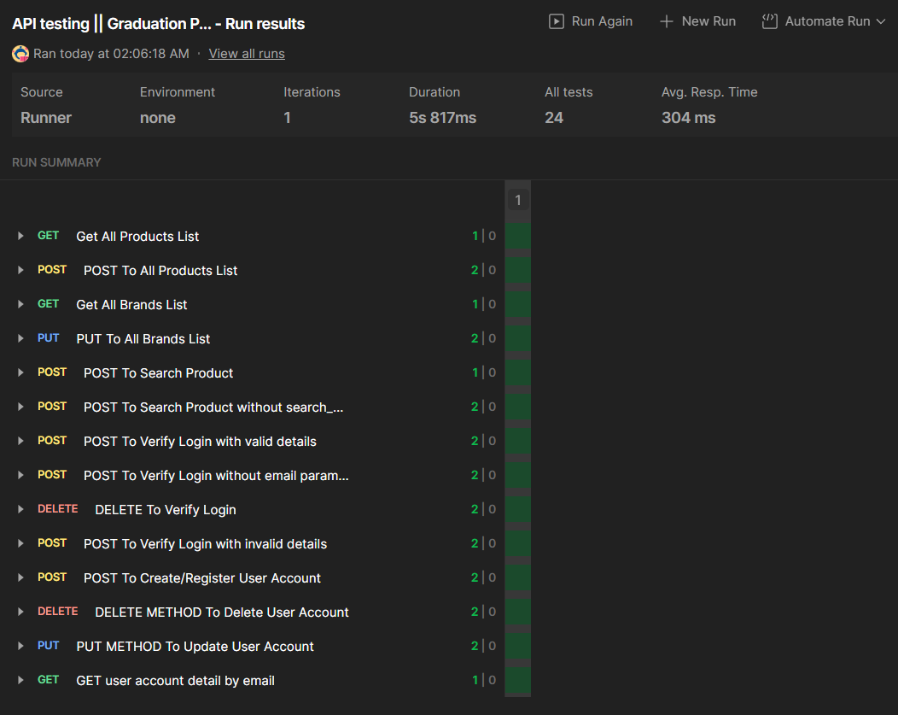
ONL3_SWD6_G3
RUNNING COLLECTION

Slide 19
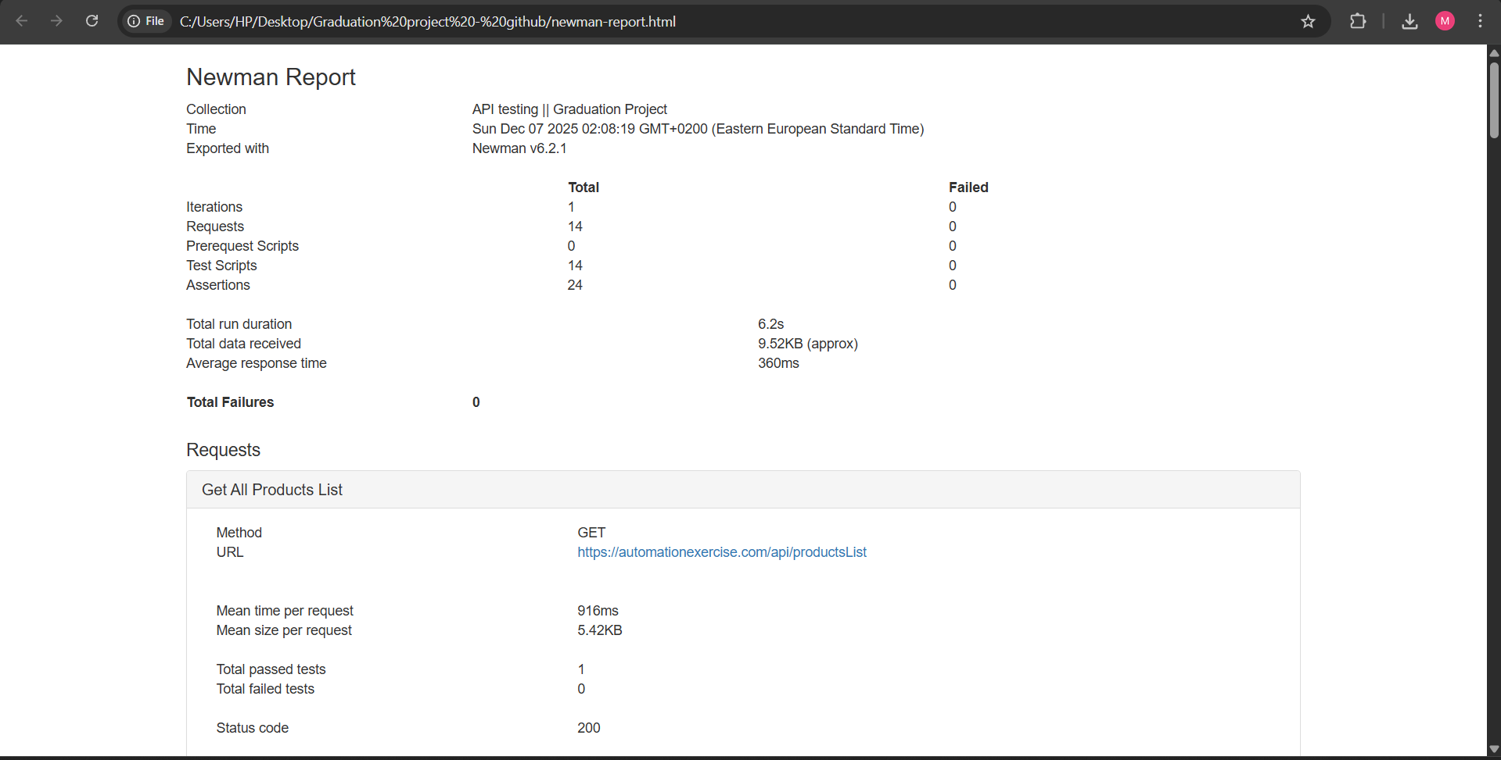
NEWMAN REPORT
ONL3_SWD6_G3

Slide 20

ONL3_SWD6_G3
AUTOMATION TESTING

Slide 21






ONL3_SWD6_G3
TOOLS
Page 33

Slide 22
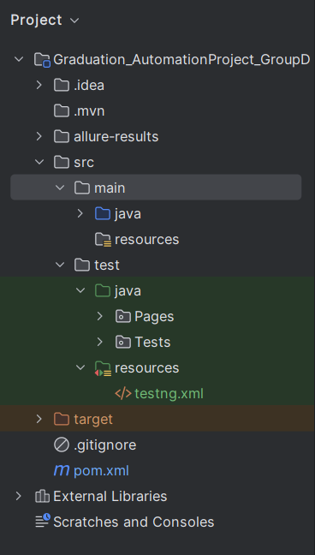
Project Structure

Slide 23
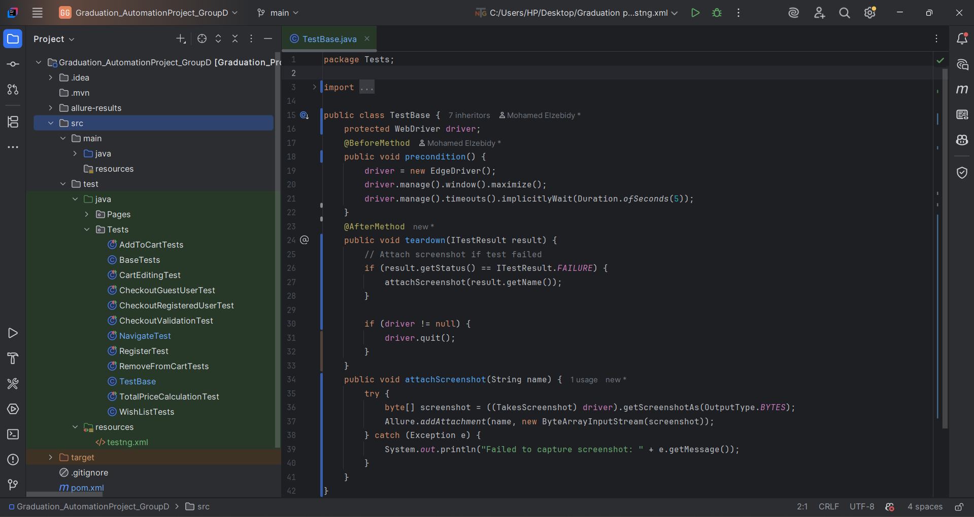
BASETEST

Slide 24
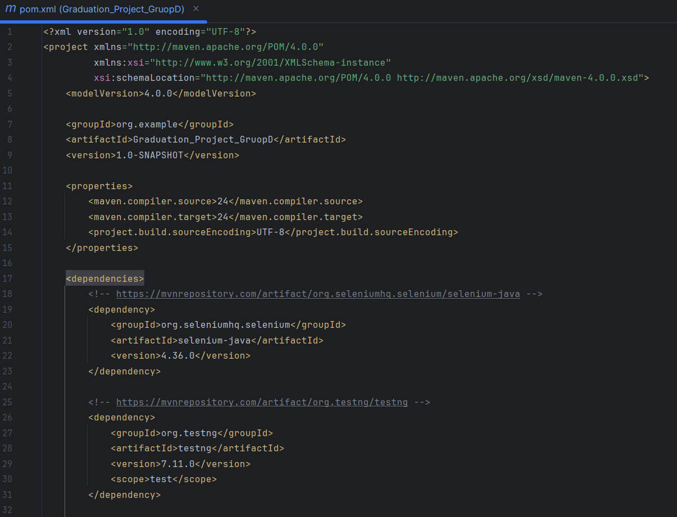
POM.XML
DEPENDENCIES

Slide 25
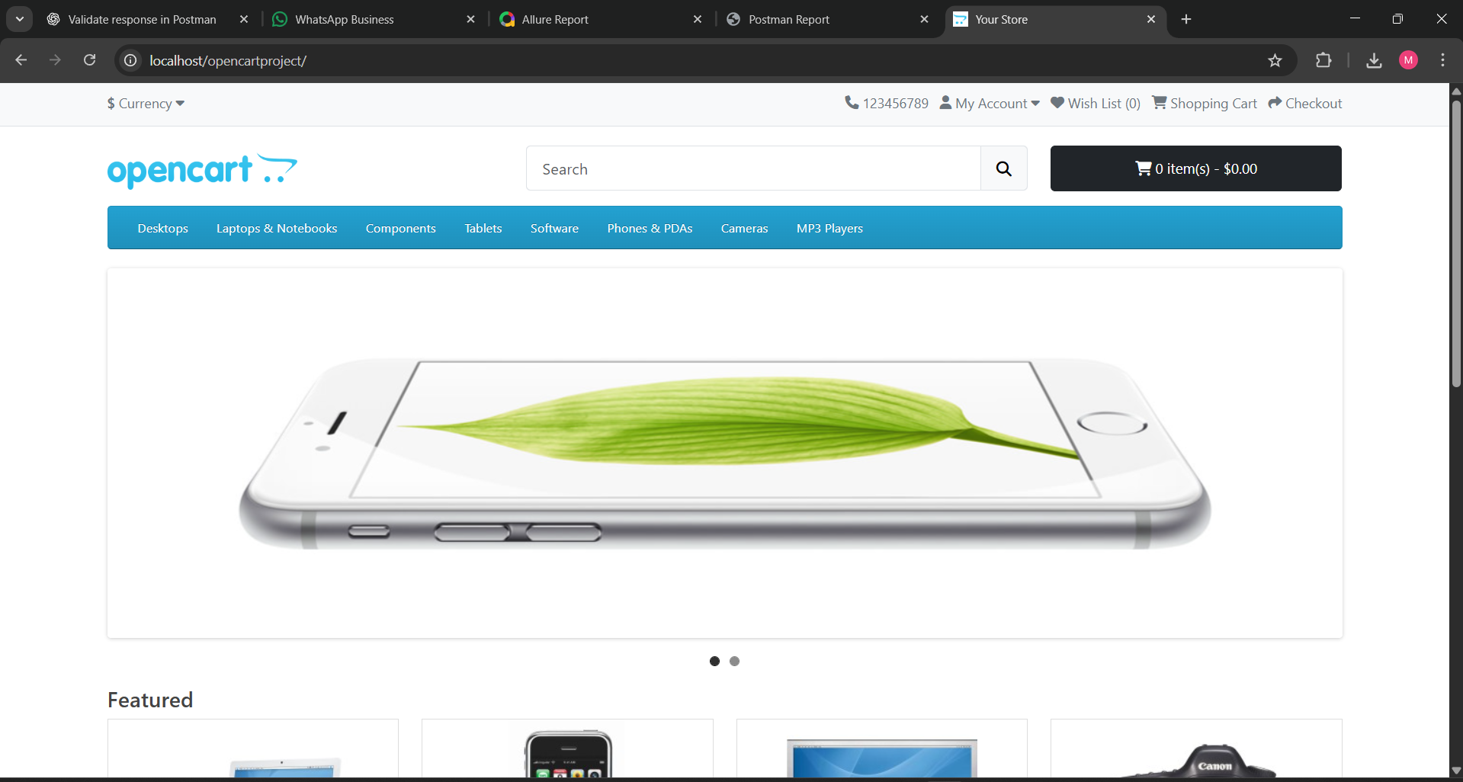
HOME PAGE

Slide 26
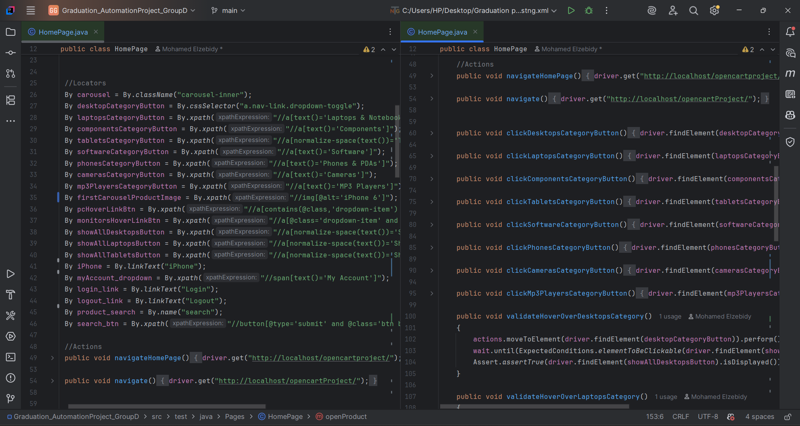
HOME PAGE

Slide 27
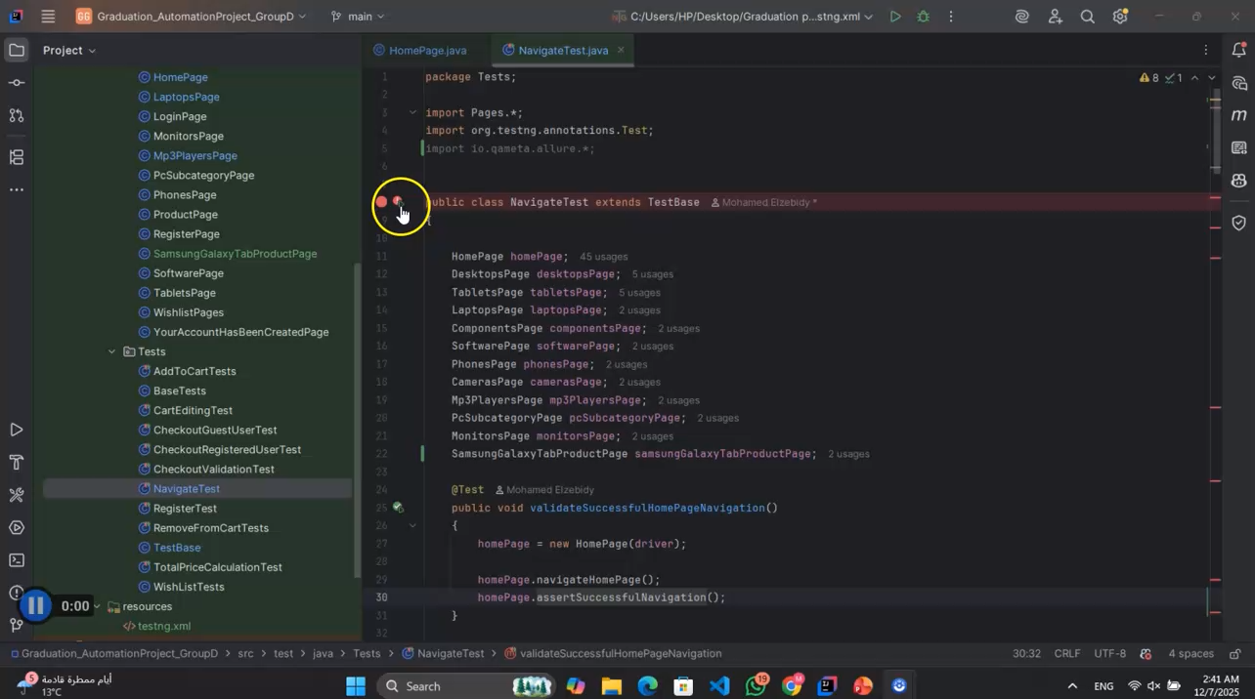
NAVIGATION FEATURE

Slide 28
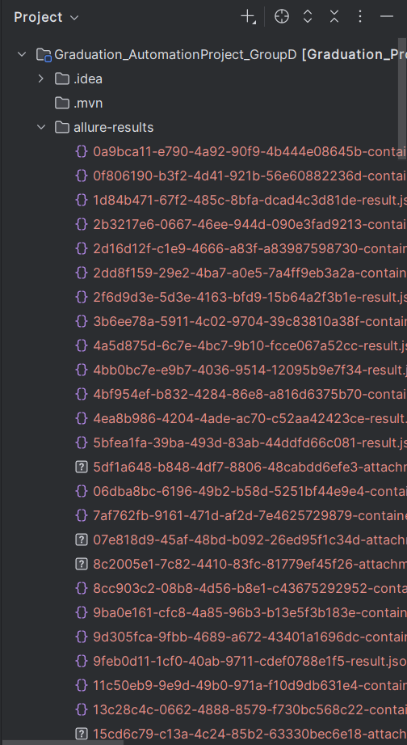
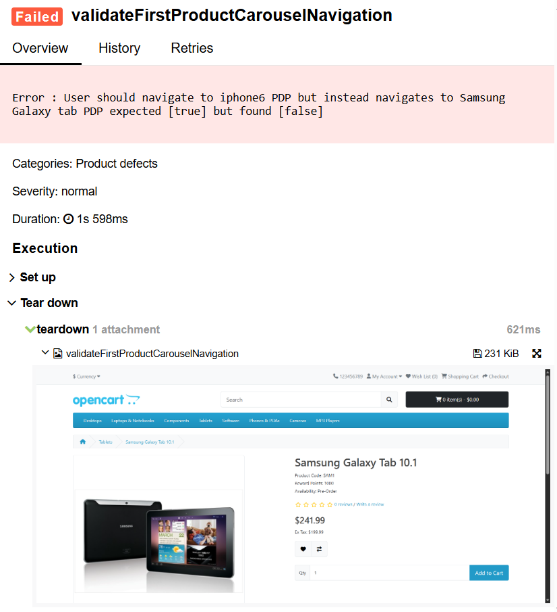
ALLURE REPORT
ATTACHED SCREENSHOT

Slide 29
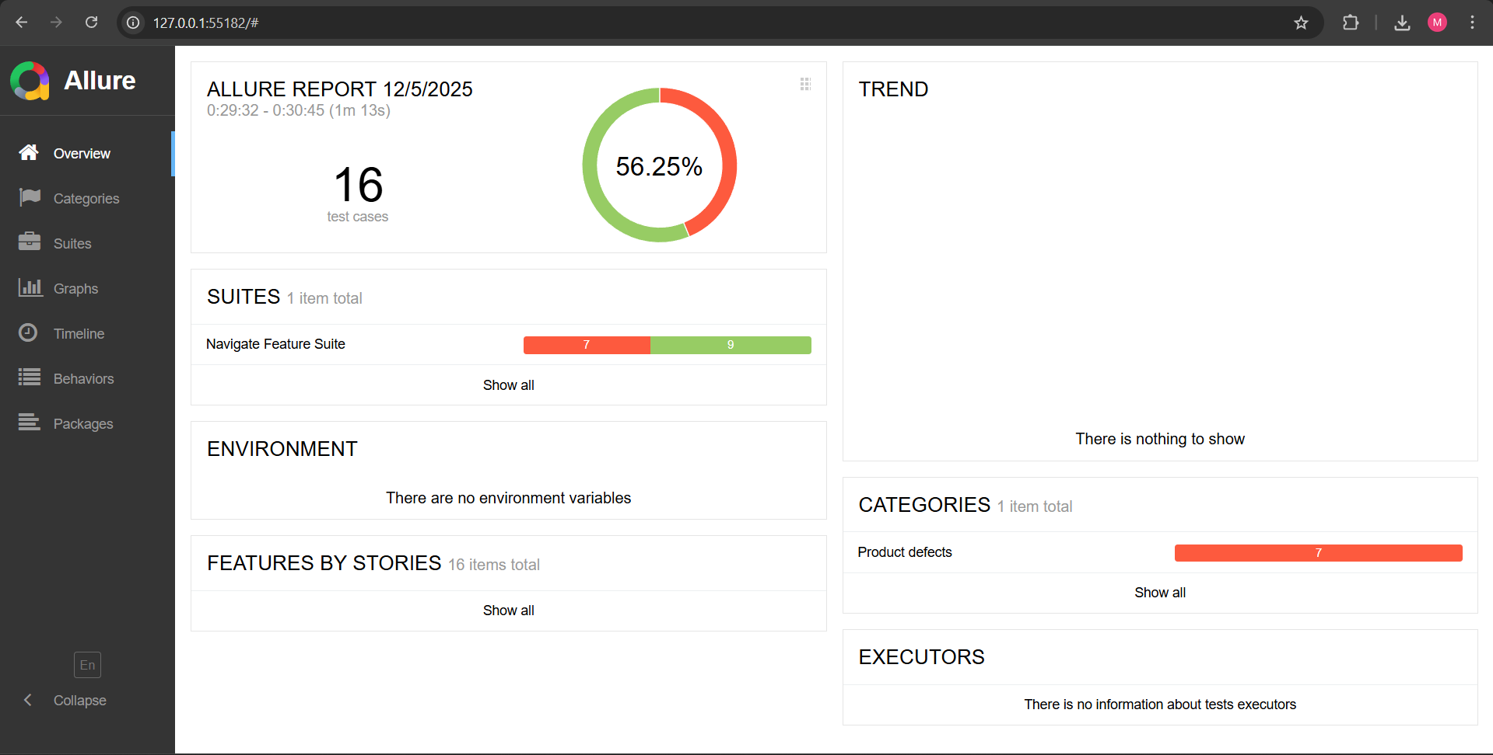
ALLURE REPORT

Slide 30
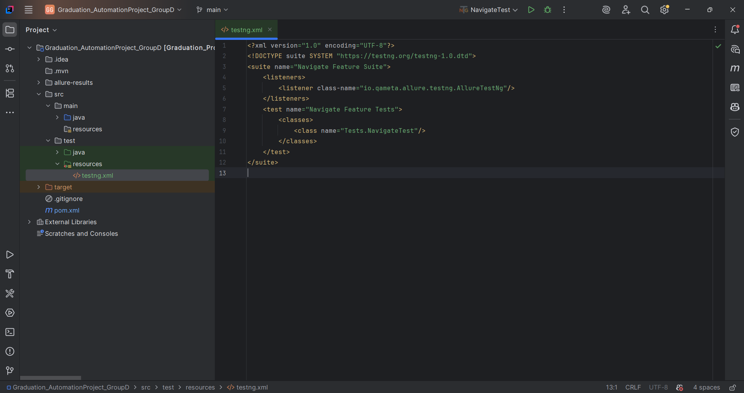
TESTNG.XML
Page 53

Slide 31

DEPI | 2025
THANK YOU
ONL3_SWD6_G3

